Slide 1
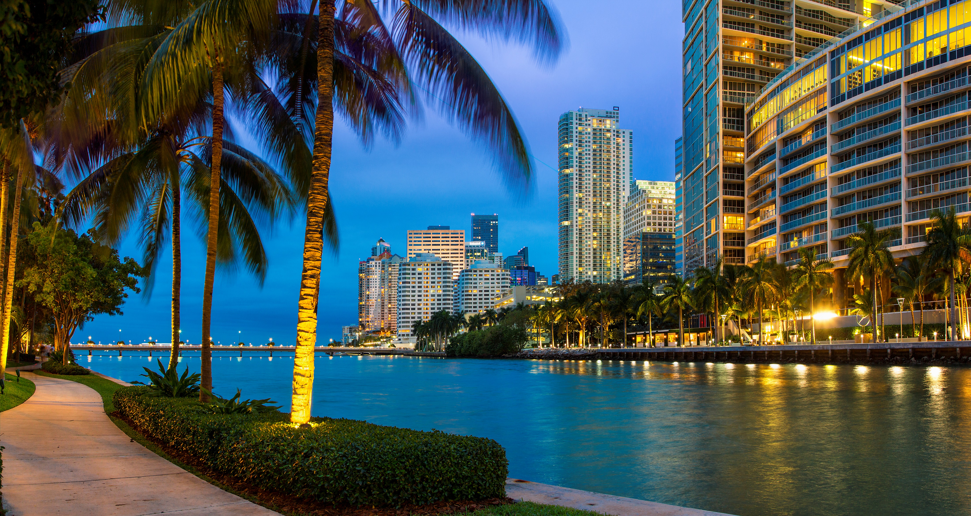


Promotional Kit
Miami, USA
13-15 May 2025
#CNSPartnership

Slide 2
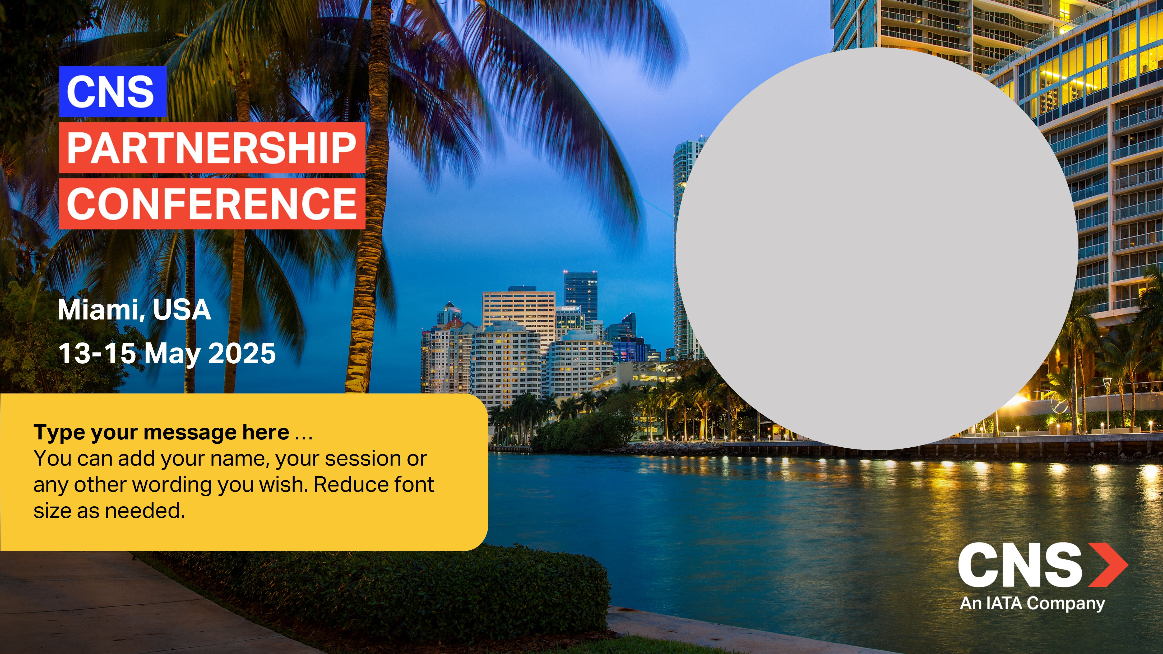
Event Promotion
Customize your own banner to promote your participation at the CNS!
STEP 1: In the next slide click in the circle to insert your profile picture
STEP 2: Enter a message of your choice in the box
STEP 3: Select all the items on the slide (CTRL+A), click right and hit “Save as picture”
Your banner is ready to use. Make sure to include the link to the CNS Website!

Slide 3
Miami, USA
13-15 May 2025
Type your message here …
You can add your name, your session or any other wording you wish. Reduce font size as needed.

Slide 4
Miami, USA
13-15 2025
JOIN ME AT
CNS Miami 2025!
#CNSPartnership

