Slide 1
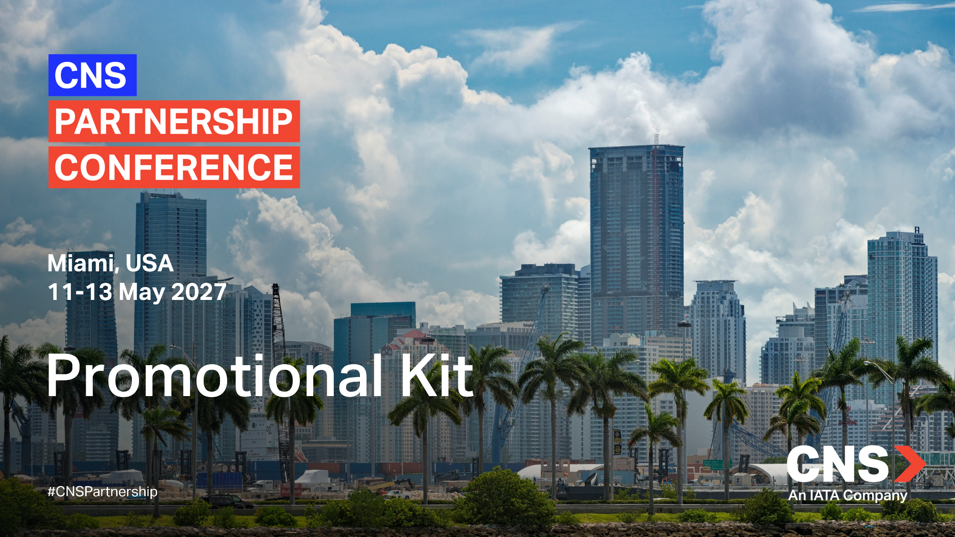

Slide 2
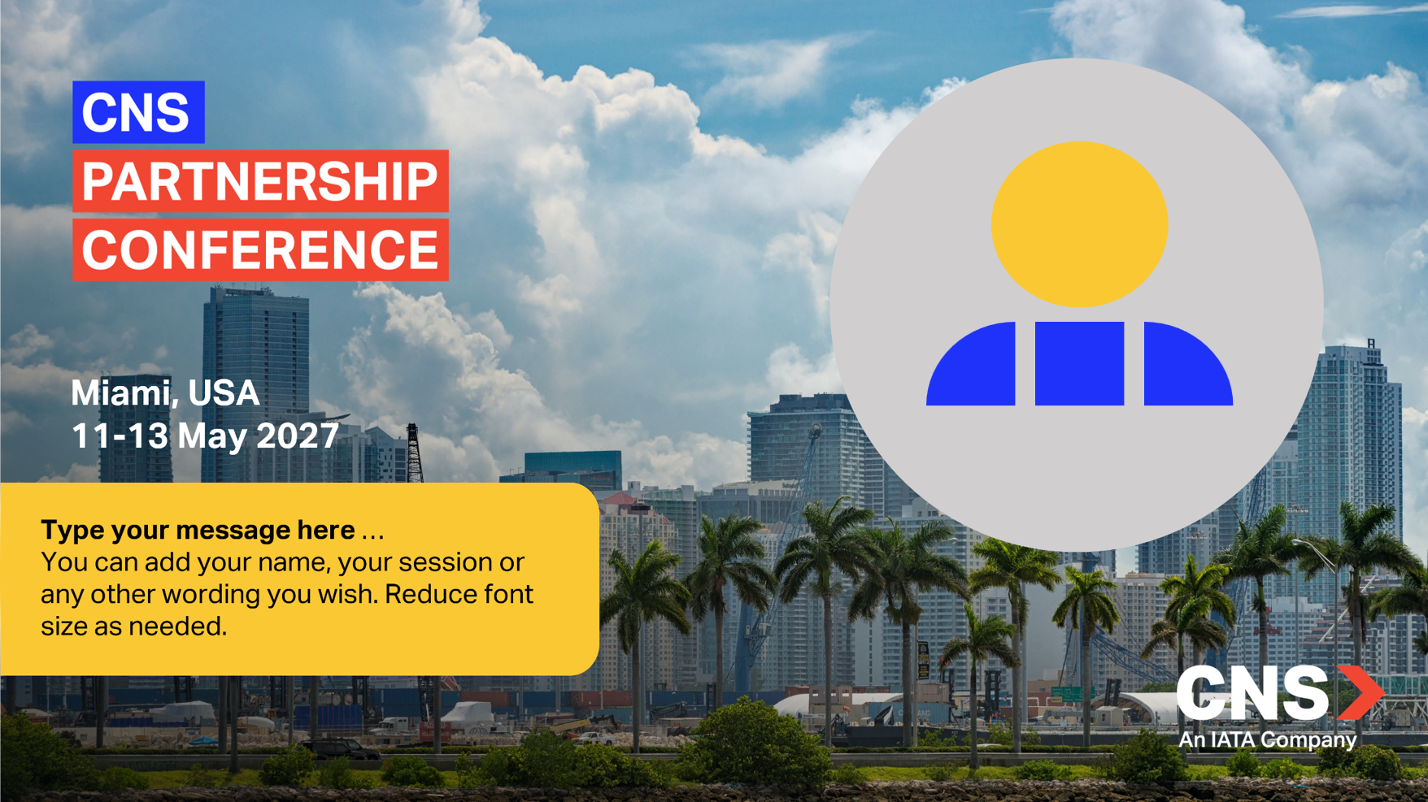
Event Promotion
Customize your own banner to promote your participation at the CNS!
STEP 1: In the next slide click in the circle to insert your profile picture
STEP 2: Enter a message of your choice in the box
STEP 3: Select all the items on the slide (CTRL+A), click right and hit “Save as picture”
Your banner is ready to use. Make sure to include the link to the CNS Website!

Slide 3
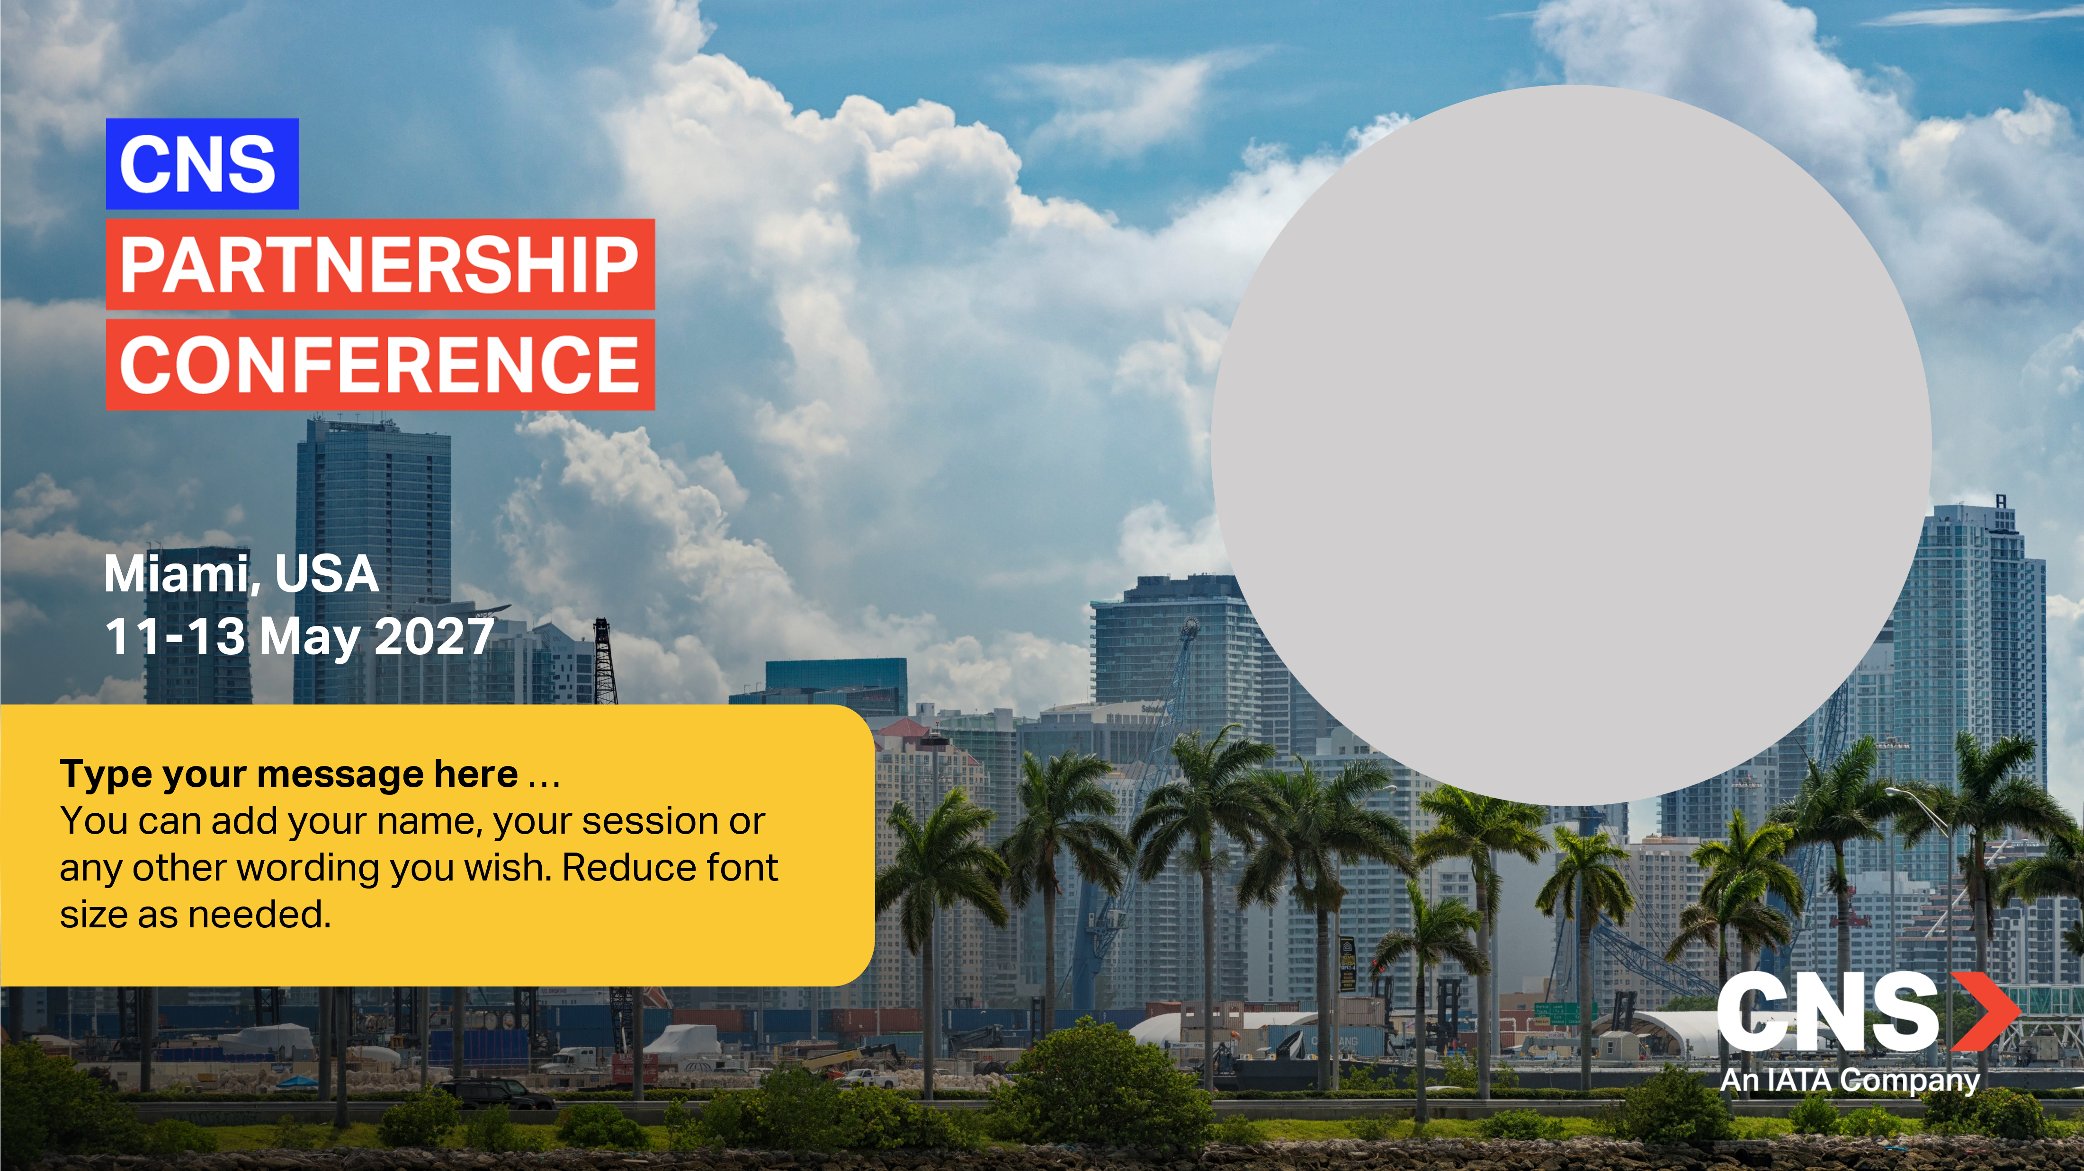
Type your message here …
You can add your name, your session or any other wording you wish. Reduce font size as needed.

Slide 4


